Slide 1

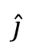
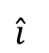
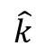
Z
$$\hat{k}$$
O(0,0,0)
$$\hat{j}$$
Y
$$\hat{i}$$
X

Slide 2
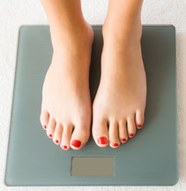
650 N
Weight: kilograms or newtons?

Slide 3
N
Y
vertical axis
Y
W
E
X
horizontal axis
X
S

Slide 4


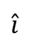
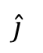
Y
X
System: box
Y
40 N
box starts to move
$$\hat{j}$$
X
kinetic friction
$$\hat{i}$$
40 N
static friction

Slide 5
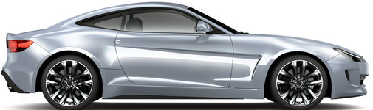
air flow

Slide 6
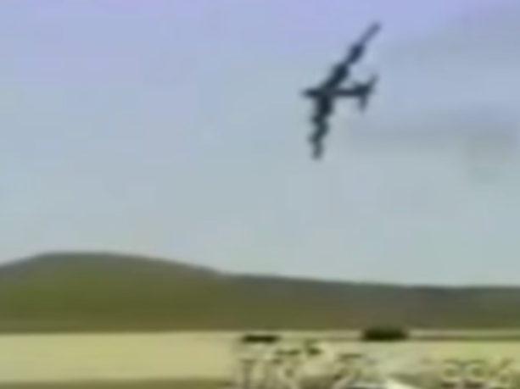
Why did the B52 bomber fall out of the sky with no survivors?

Slide 7
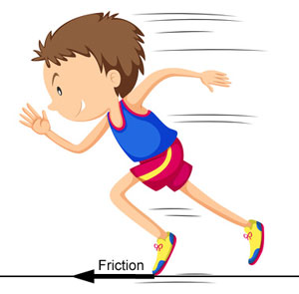
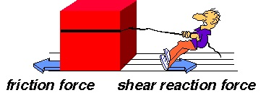
Can you identify the friction forces?

Slide 8
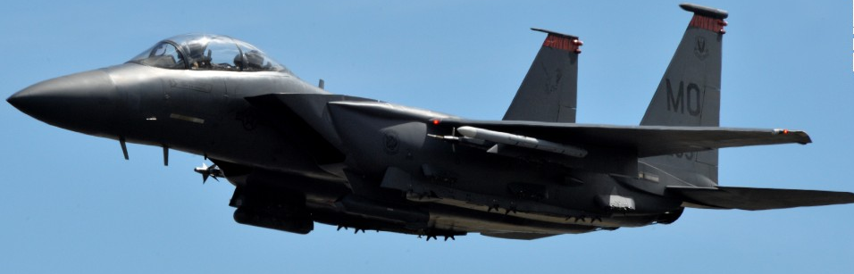
Y
$$\hat{j}$$
$$\hat{i}$$
X

Slide 9
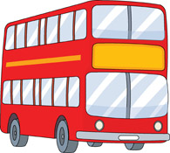

Slide 10
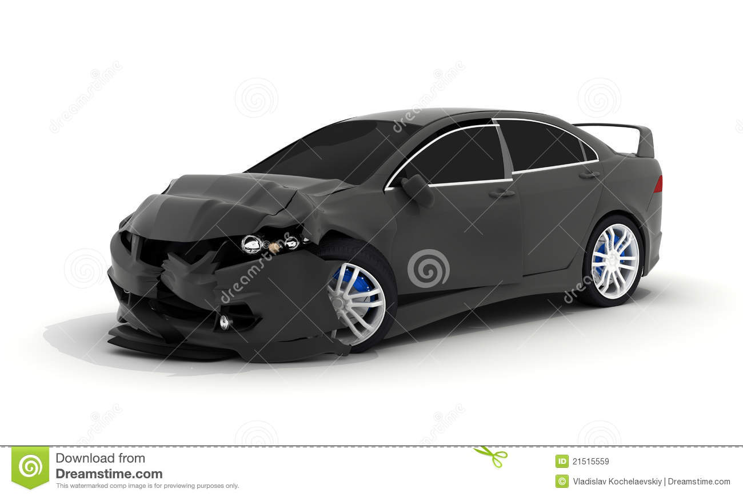
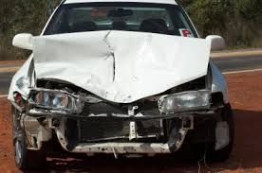
crumple zone

Slide 11
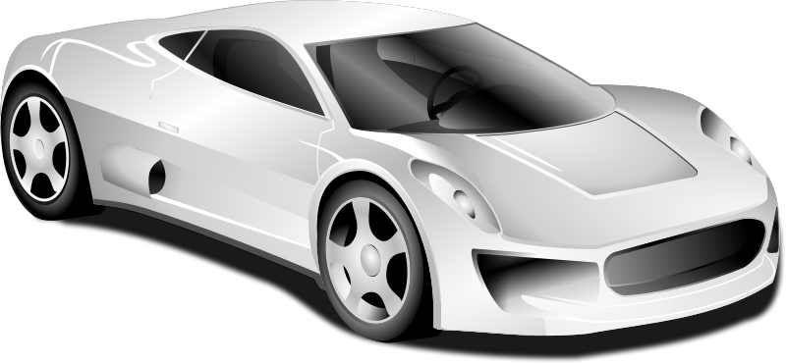
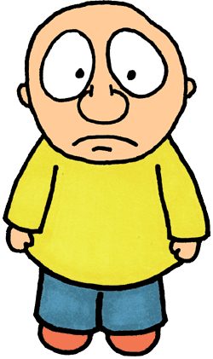
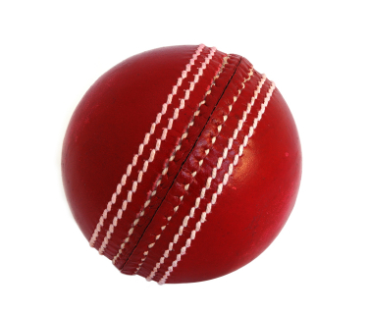

Slide 12
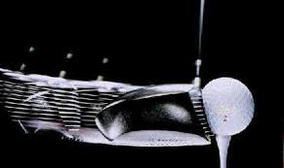
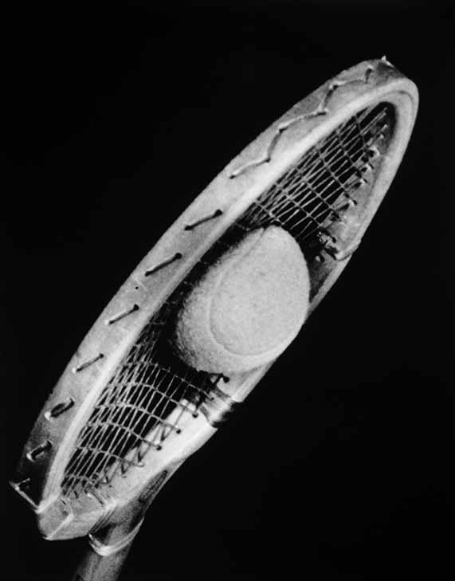
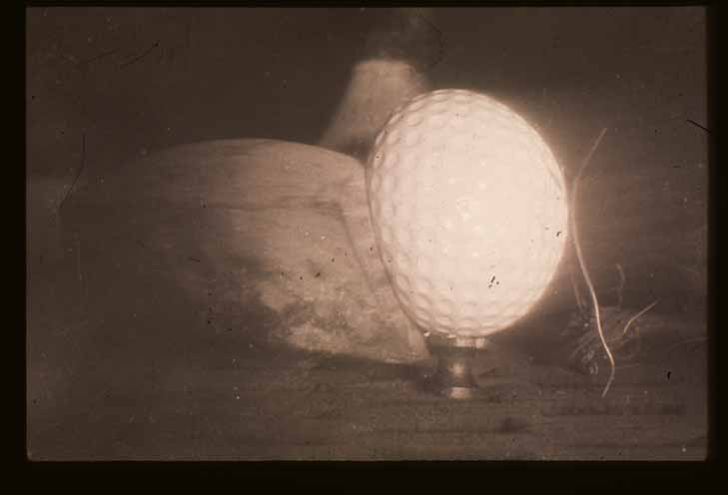

Slide 13
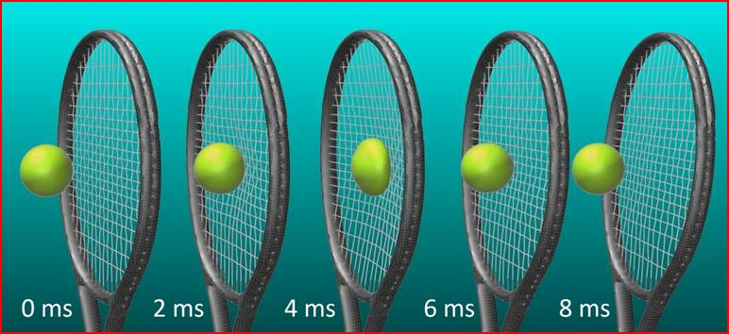
impact
Event #1 t₁
(just before impact)
Event #2 t₂
(just after impact)

Slide 14
impact
Y
$$\hat{j}$$
$$\hat{i}$$
X
Event #1 t₁ s₁
(just before impact)
Event #2 t₂ s₂
(just after impact)
assume [1D] collision

Slide 15
force
time

Slide 17
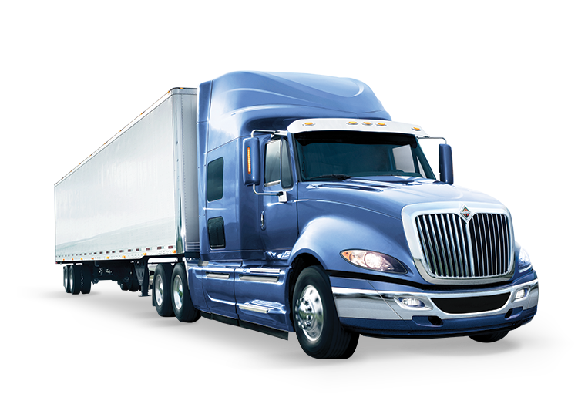
car: System C
truck: System T
Y
$$\hat{j}$$
$$\hat{i}$$
X

Slide 18
car
Y
$$\hat{j}$$
$$\hat{i}$$
Event #1 initial values
Event #2 final values

Slide 19
car: System C
truck: System T
Y
$$\hat{j}$$
$$\hat{i}$$
X
Event #1
initial values
Event #2
final

Slide 20
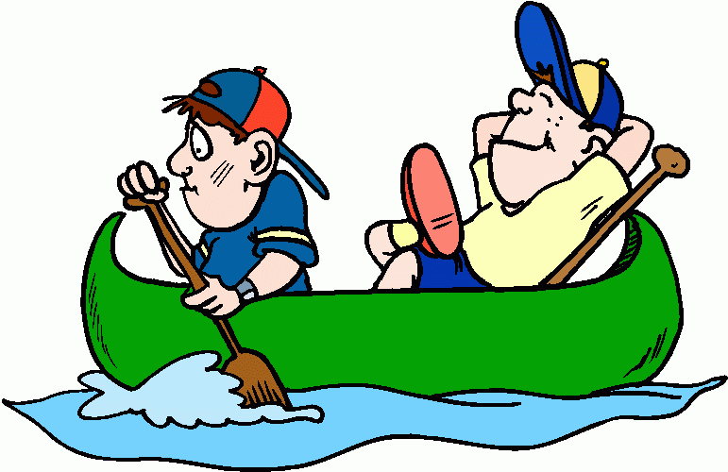
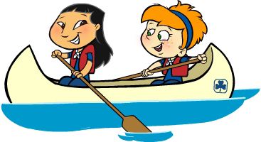
Y
$$\hat{j}$$
$$\hat{i}$$
X
System A
System B

Slide 21
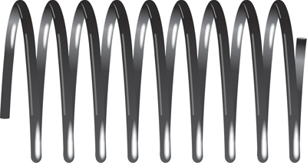
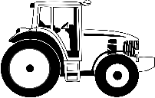

Slide 22
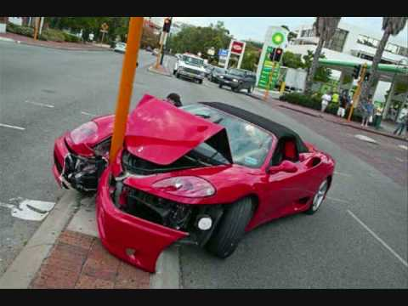
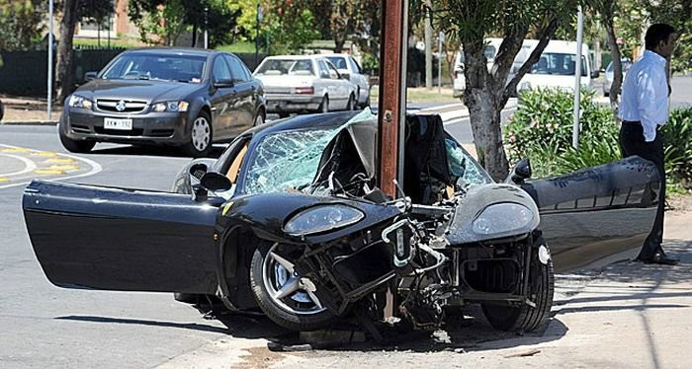
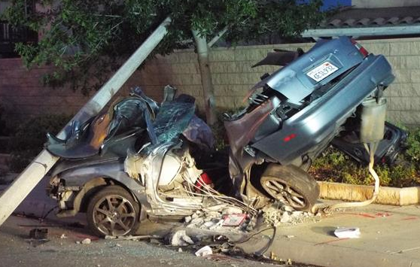

Slide 23
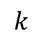
$$k$$
equilibrium
position
Y
$$\hat{j}$$
X
System: Block
$$\hat{i}$$
System: mass / spring

Slide 24
Y
Y
$$\hat{j}$$
$$\hat{i}$$
X
X
O(0, 0)

Slide 25

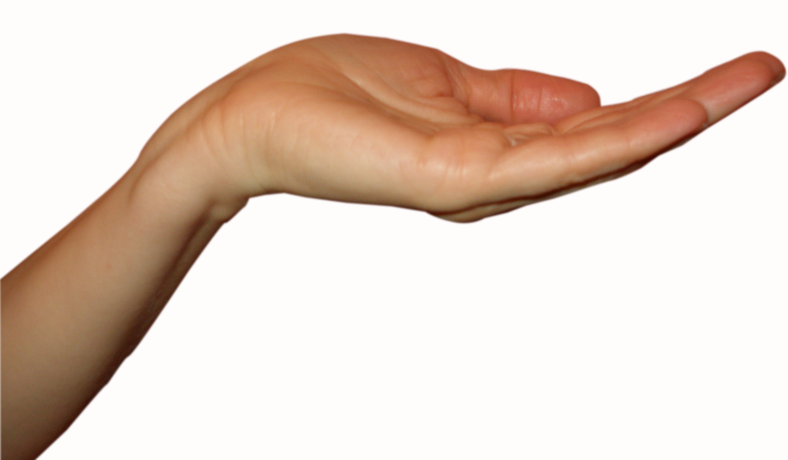
Y
Y
Y
$$\hat{j}$$
$$\hat{i}$$
X

Slide 26
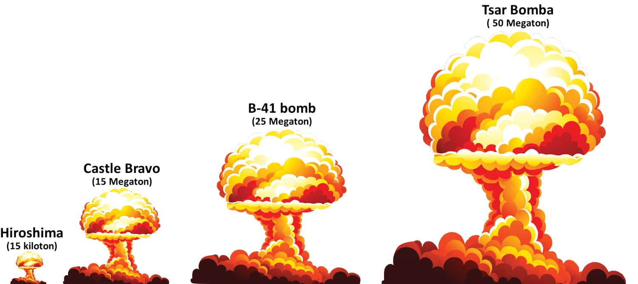

Slide 27
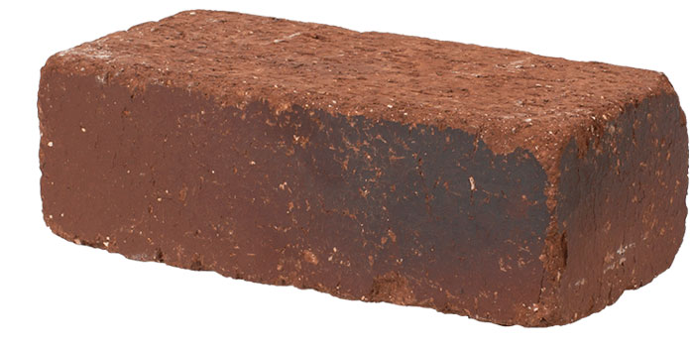
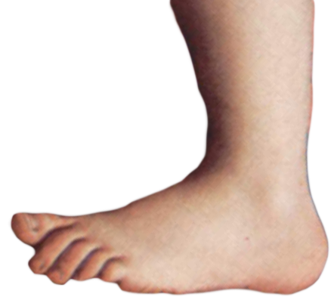
bricks fall from rest
“lots of stored energy”
→ damage the toes
“not much stored energy”
→ not damage the toes

Slide 29
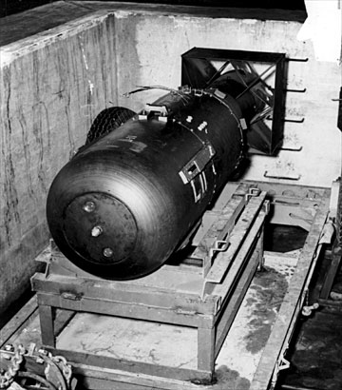
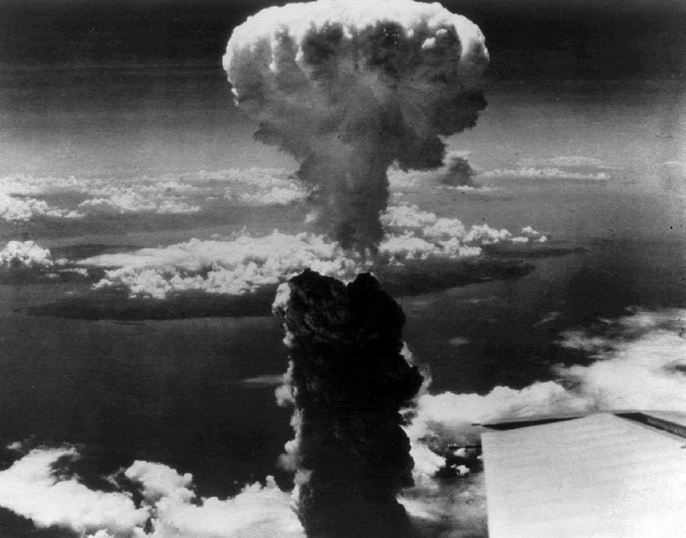
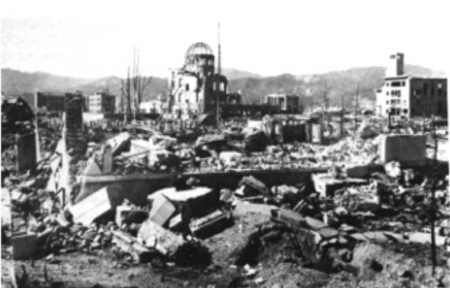
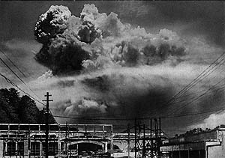

Slide 30
System
B
A

Slide 31
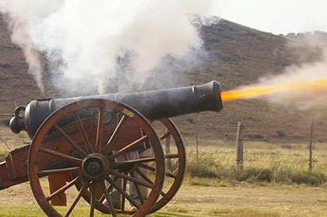
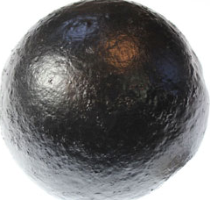
System
Event #1
just before explosion
Y
$$\hat{j}$$
Event #2
just after explosion
$$\hat{i}$$
X
cannon C
ball B
X
muzzle velocity ball

Slide 32
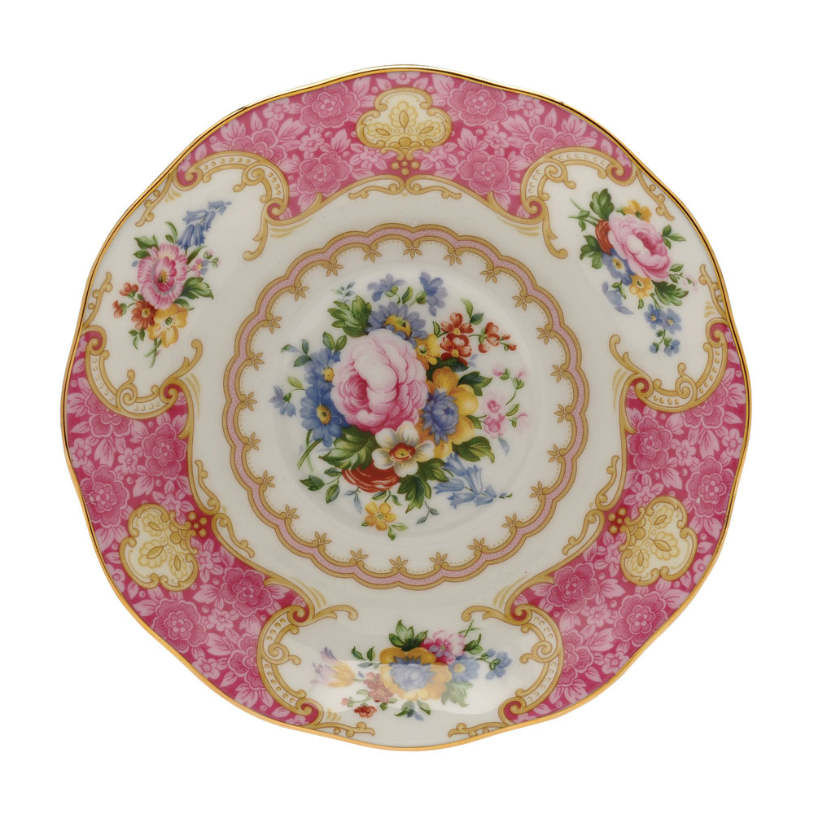

Y
$$\hat{j}$$
$$\hat{i}$$
X
A
C
X
B

Slide 33
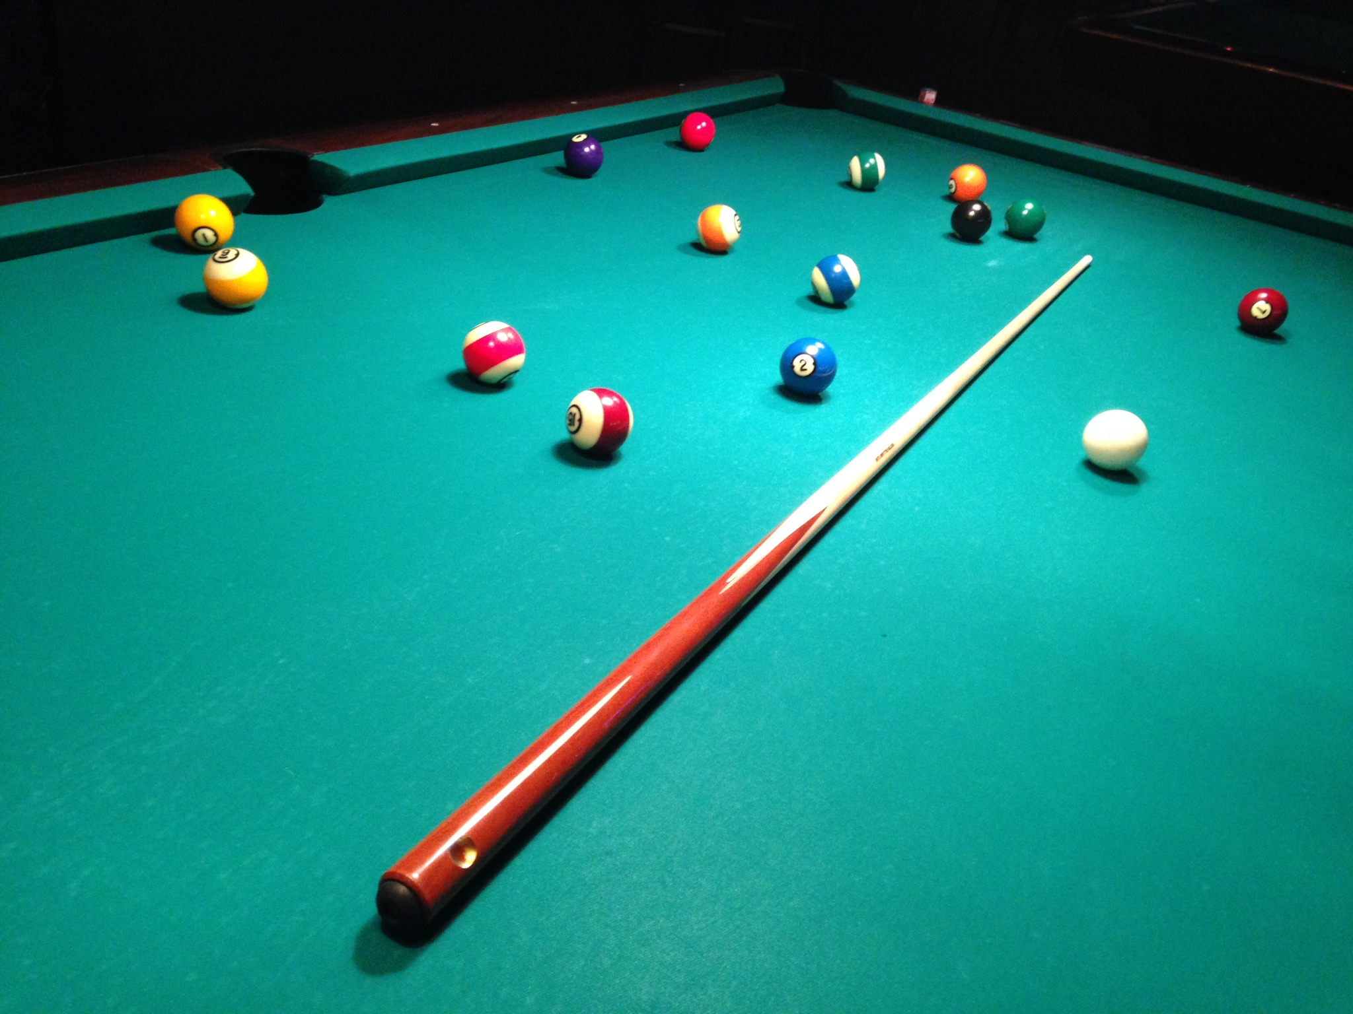
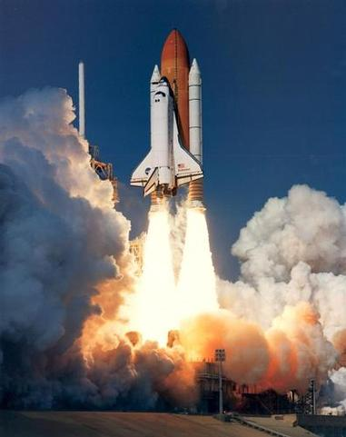
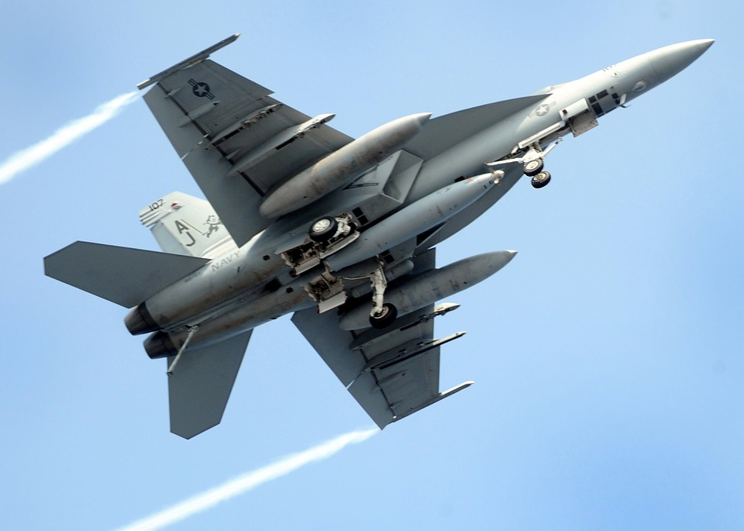
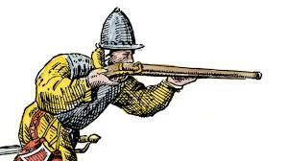
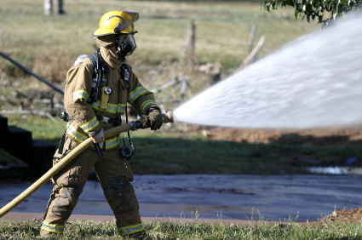
shoulder damaged by recoil – why?

Slide 34
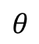
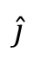
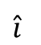
Y
$$\hat{j}$$
$$θ$$
$$\hat{i}$$
O(0, 0)
X

Slide 35
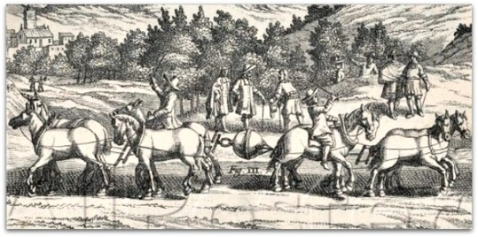







Slide 36


Slide 37

Event #1: just before collision
Y
$$\hat{j}$$
$$\hat{i}$$
X
Event #2: just after collision

Slide 38



Slide 39
Event #1:
just before collision
Event #2:
just after collision
Y
$$\hat{j}$$
$$\hat{i}$$
X

Slide 40




$$\hat{j}$$
$$\hat{i}$$
A
B

Slide 41
Y
Event #2:
Just after collision
Event #1:
Just before collision
$$\hat{j}$$
$$\hat{i}$$
X

Slide 42
Y
Event #2:
Just after collision
Event #1:
Just before collision
$$\hat{j}$$
$$\hat{i}$$
X

Slide 43
Y
Event #2:
Just after collision
Event #1:
Just before collision
$$\hat{j}$$
$$\hat{i}$$
X

Slide 45

A
B
100 m
C
D
180 m
120 m
90 m

Slide 46


System is the ball
?

Slide 47

System: basketball and Earth
B
B
B
E
E
E
Momentum is conserved

Slide 48
K.E. lost
during impact
falling ball
rising ball

Slide 49
Y
ball stick
no bounce
ball bounces
$$\hat{j}$$
$$\hat{i}$$
X
just before impact
just after impact
Impulse =
change in momentum

Slide 50
d
deformation of sphere
and surface

Slide 51


The ferrari has a small frontal area and shaped to reduce air drag to give better acceleration and fuel efficiency.
The bike, clothing and helmet are designed to reduce air drag which opposes the forward motion of the bike and rider.

Slide 52
Y
X

Slide 53
N
velocity of the plane w.r.t. air
plane (P)
N
E
velocity of the plane w.r.t. ground
S
air - wind (A)
velocity of the air w.r.t. ground
Y
X
observer: ground (G)

Slide 54
N
system A
system B
N
E
Case 1
Y
S
Case 2
X
Case 3
A
B
vectors not to scale

Slide 57


Y
X
C
G
canoe is the system

Slide 58
Y
A
B
O(0, 0)
X
C

Slide 59




Slide 60





system: truck
system: ball
?
Pat
?
Chris

Slide 61
Event #1: time t₁ = 0 s
ball released from block
Start clock
Event #2: time t₂ = t s
ball hits block
Stop clock
s
ramp set at a small angle so that time intervals can be measured with stop watch

Slide 62

Y
X
O(0, 0) front of ball
s
t

Slide 63

lwf
lbf

Slide 64

lbf
lwf

Slide 65

The force of the wind causes the blades to be displaced hence doing work on the wind turbine.
kinetic energy electrical energy

Slide 66

Can we predict the velocities after the collision?

